Slide 1

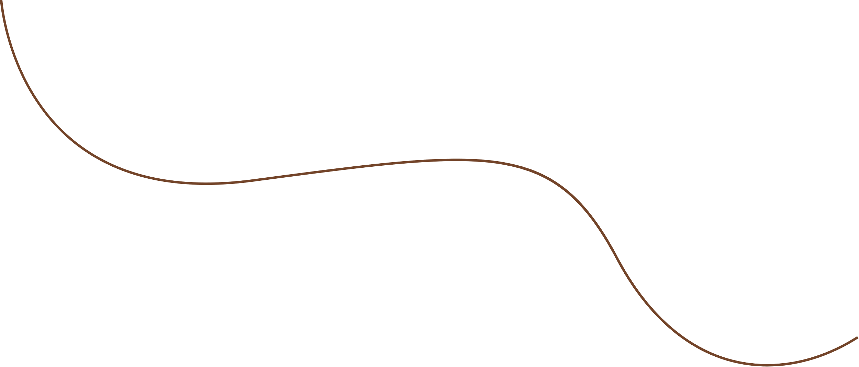

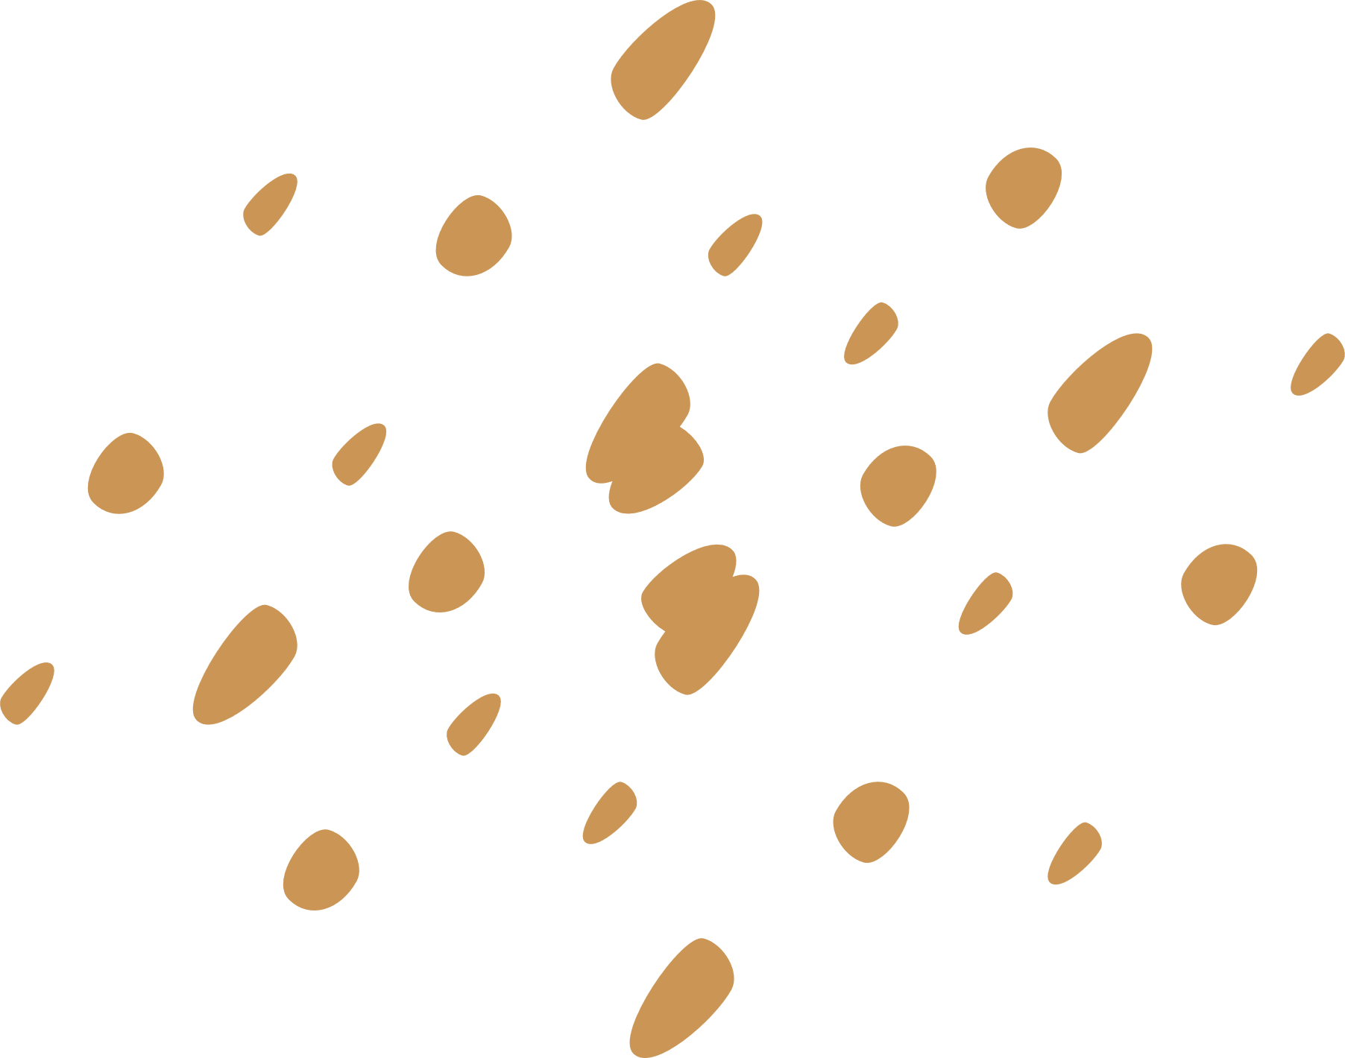


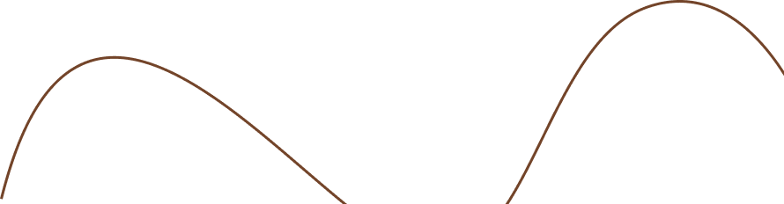
Ceramics Inventory Management System
A. Satterfield
COMPSCI-2
11/13/2024

Slide 2

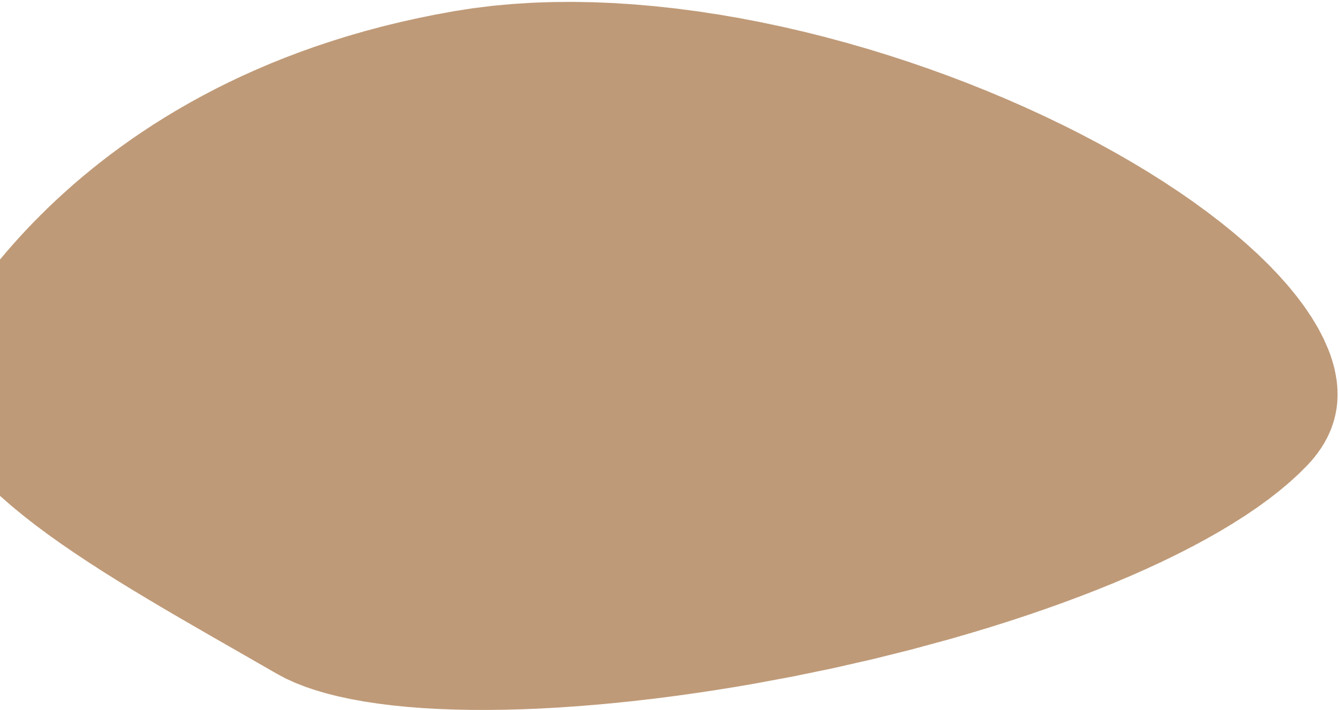



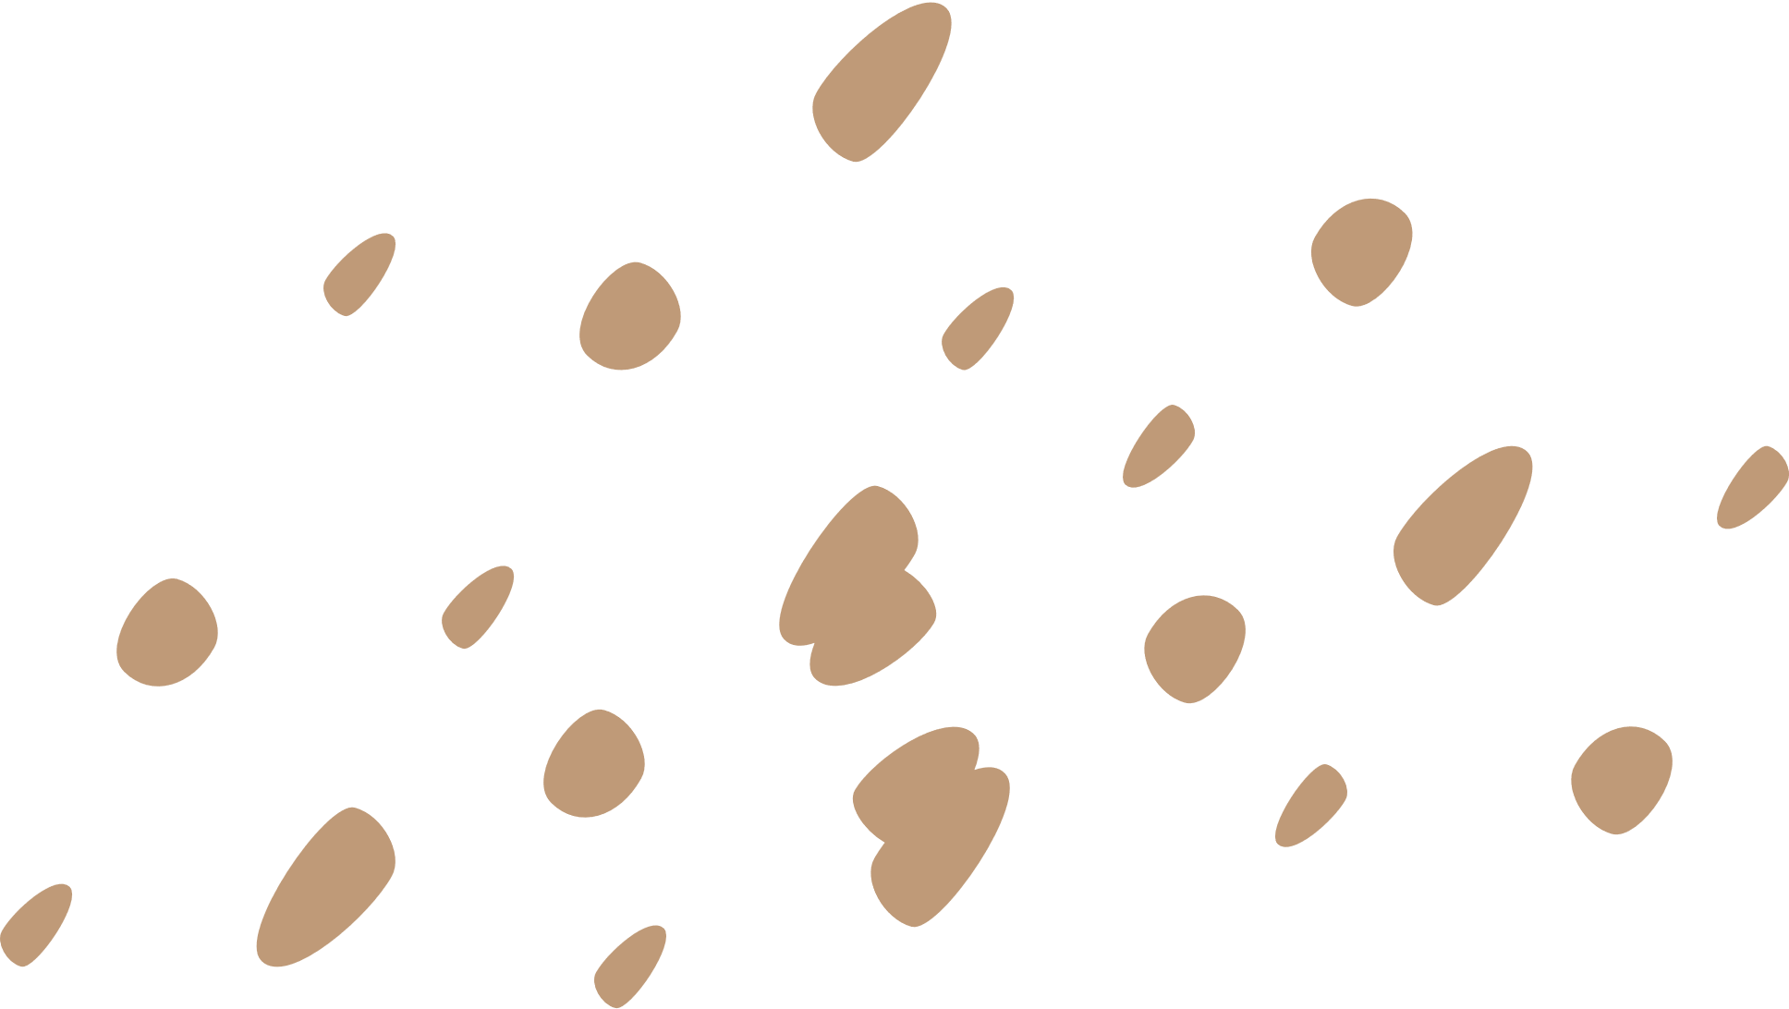
Introduction
I am passionate about both programming and ceramics. Outside of coding, I enjoy working with clay and making ceramic sculptures.
The inspiration for this project came from my own experience with ceramics. Keeping track of pieces as they go through different stages—like bisquing, glazing, and firing—can be challenging. So, I wanted to create an inventory system that could organize these pieces and record details like clay type, texture, and stage of completion.
This project combines my interests in programming and ceramics, offering a solution for artists and enthusiasts who need a way to track their creations.

Slide 3
Project Implementation
The project is organized around two main classes: CeramicPiece and Inventory.
The CeramicPiece class represents individual pieces, storing details such as name, dimensions, clay type, texture, and stage of completion.
The Inventory class manages a collection of these pieces and allows us to add, filter, save, and load them.
The code is divided into modular components, with each class having separate .cpp and .h files. This modular setup helps keep the project organized and also makes it easier to debug and extend in the future.
To handle data input and output, I used file streams for saving and loading inventory data to and from CSV files, ensuring persistence across sessions.
Pointers are used in the inventory system to access and manipulate objects within the vector.

Slide 4
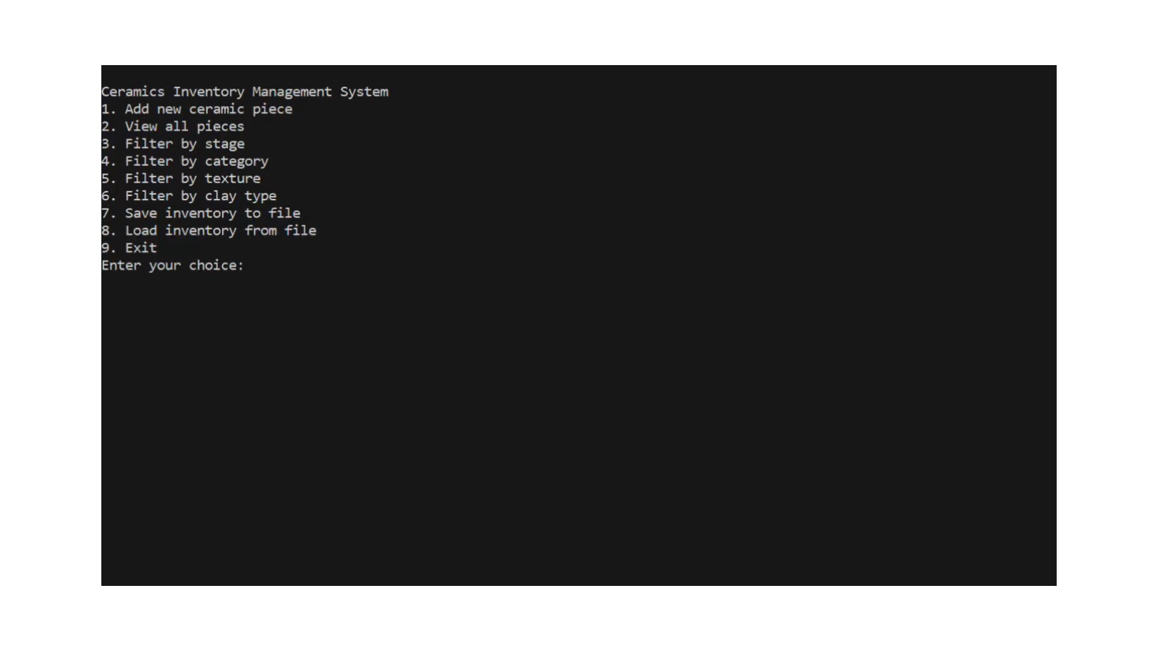
Demo

Slide 5
Project Implementation
There are a few areas where I’d like to expand this project in the future:
Add sorting functionality, allowing users to organize pieces by attributes like weight, size, or stage.
Incorporate a graphical user interface to make it more accessible for artists who may not be familiar with command-line interfaces.
I’d like to add glaze as an option to sort by and allow users to add any glazes that they have
To conclude, this project has been a rewarding opportunity to apply concepts like object-oriented programming, file handling, and modular design. It also allowed me to create something both practical and relevant to my interests in ceramics.

